Slide 1
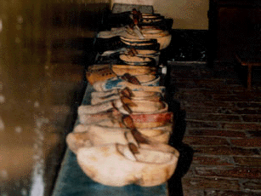
The Question Bank Cultural Changes in the Netherlands Marion Wittenberg Project manager Social Sciences DANS
Data Archiving and Networked Services

Slide 2
Outline of my presentation
DANS collections
Background of the study Cultural Changes
The Question database
The new Question databank
DDI issues

Slide 3
DANS collections
DANS Electronic Archiving System – EASY
Social sciences
Archaeology
Oral History
History
Language and Literature Studies
Geo spatial sciences
In the future:
Biology
Metadata of the whole collection in DC
Subsets of the collection in discipline dedicated metadata
Social Sciences: DDI codebook (NESSTAR)
New project: Question bank Cultural Changes –DDI Lifcycle

Slide 4

The Survey Cultural Changes
The Netherlands Institute for Social Research (SCP)
Trend study since 1975
It measures changes in general opinions and attitudes of the Dutch population
Annual till 1999, biannual since then
Face to face and drop-off questionnaire
Until 2002 International Social Survey Programme (ISSP) part of questionnaire

Slide 5


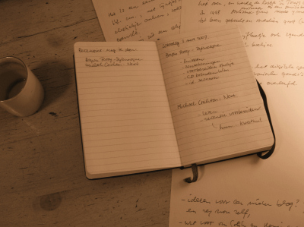
2001: Request to (predecessor) of DANS
Save the knowledge about the survey

Slide 6
Question databank Cultural changes
Documentation of every round
Variables keep their variable name over time
Variables can be part of blocks / sets
Emphasis on question wordings
Small changes in wordings can occur
Answer categories
Sample / routing information
Interview instructions
Concepts, keywords and notes

Slide 7
Functionality
Document question wordings of variables
Document questionnaires
Give an overview of the history of a variable
Select variables
Create a new questionnaire

Slide 8
Disadvantages of this system
Back office system
Only available for researchers of the SCP
No other variable information available
File information in other system
System needs update

Slide 9


Cooperation of
SCP
Centerdata
DANS
Conversion of Question Databank Cultural Changes in an instance of Questacy (databank of Centerdata)
Project will start in 2012

Slide 10
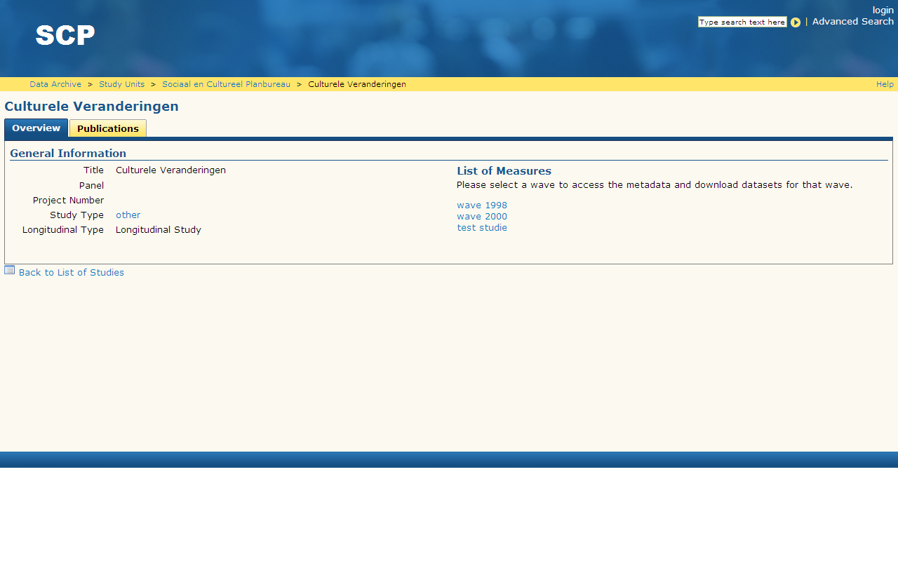

Slide 11
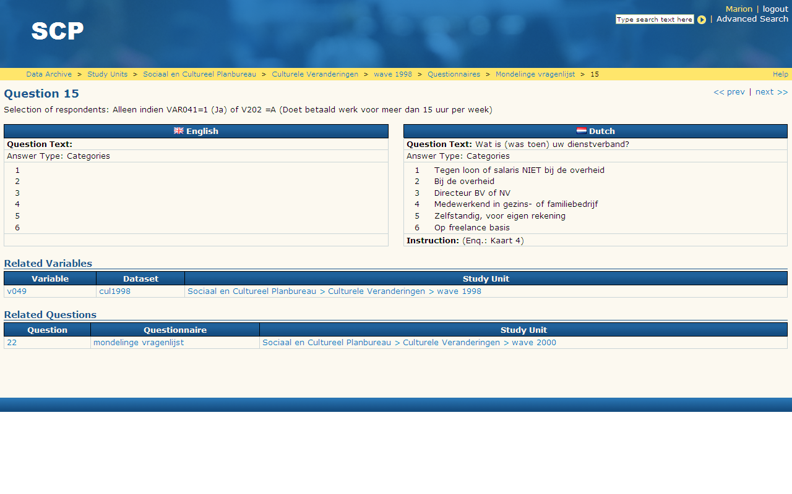

Slide 12
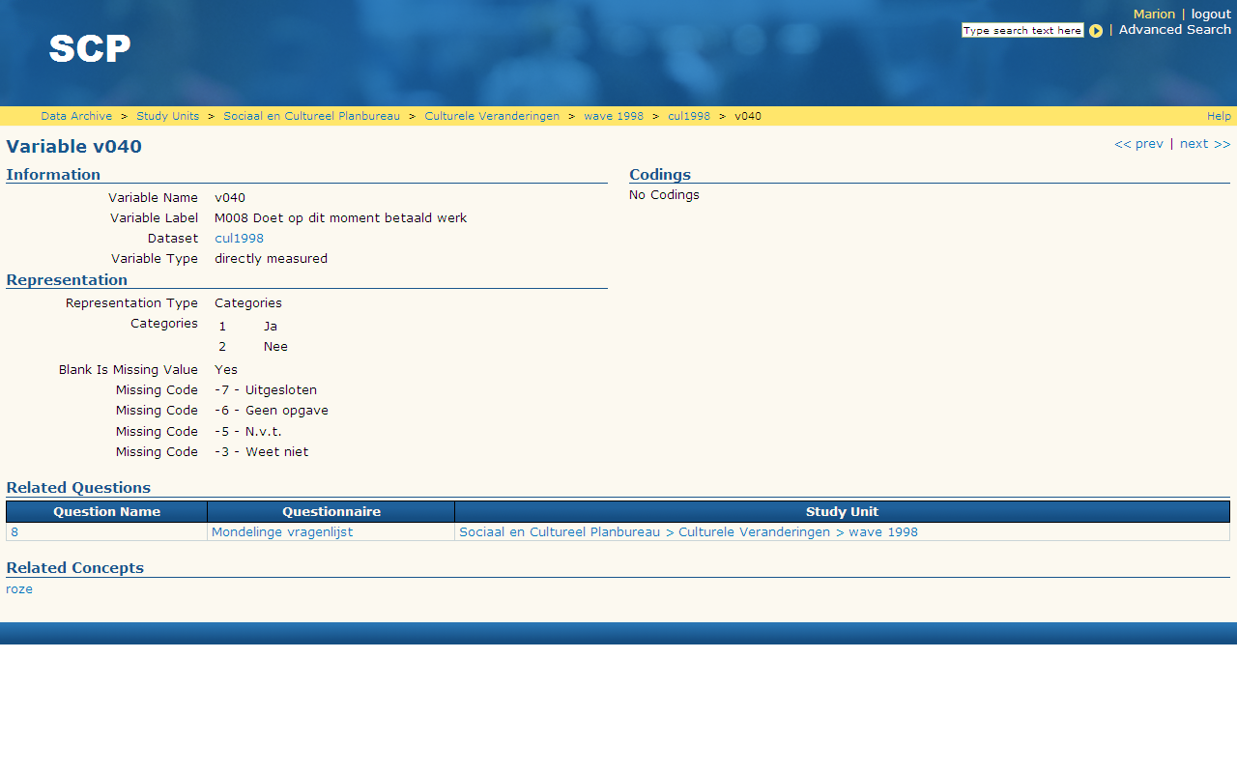
Next Question Databank Cultural Changes
Web application
Online resource for a more general public
Same functionality and more
Basket to select variables for analyses
Link to the data
Multi lingual
And in the future:
More longitudinal surveys of SCP
More major Dutch longitudinal surveys

Slide 13
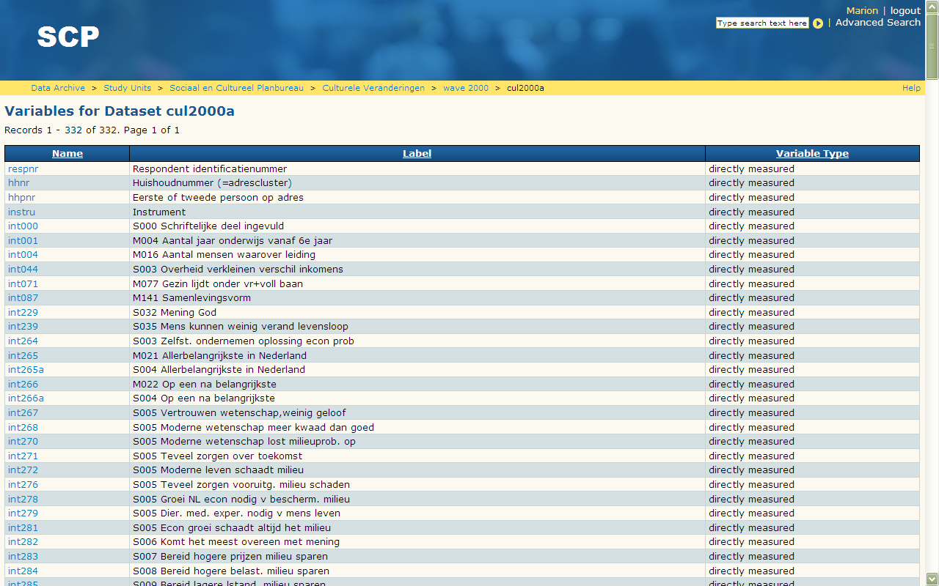

Slide 14
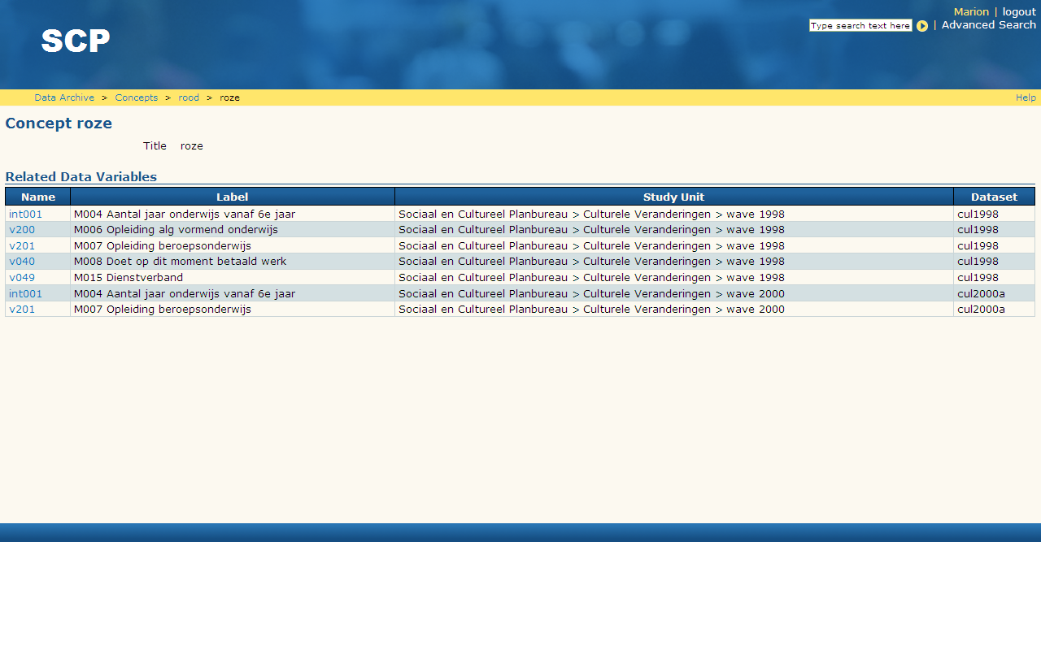

Slide 15
The new SCP question databank
Content of SCP question bank will be moved towards DDI 3.0
Online resource, also available for wider research community
Admin interface, SCP interface, Research interface
Combination of question wordings, other metadata and data
Datawarehouse
In the future probably other surveys
Pilot in April 2011, Project will start in 2012
Shopping basket for variables, design tool for questionnaires

Slide 16
DDI issues
Versioning in Questacy
Conversion
Moving content of several databases into Questacy
Conversion of NESSTAR DDI into DDI3
Combination of information
Advantage: variables have kept their name over time

Slide 17

Thank you for your attention
For more information please contact
marion.wittenberg@dans.knaw.nl

